Slide 1
Geospatial Foundation Model
IBM x NASA

Slide 2
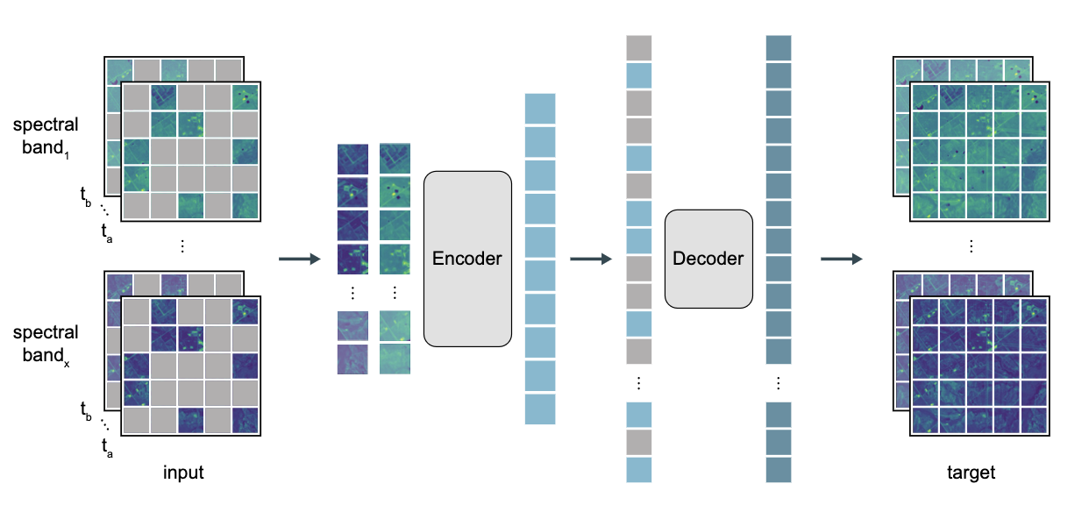
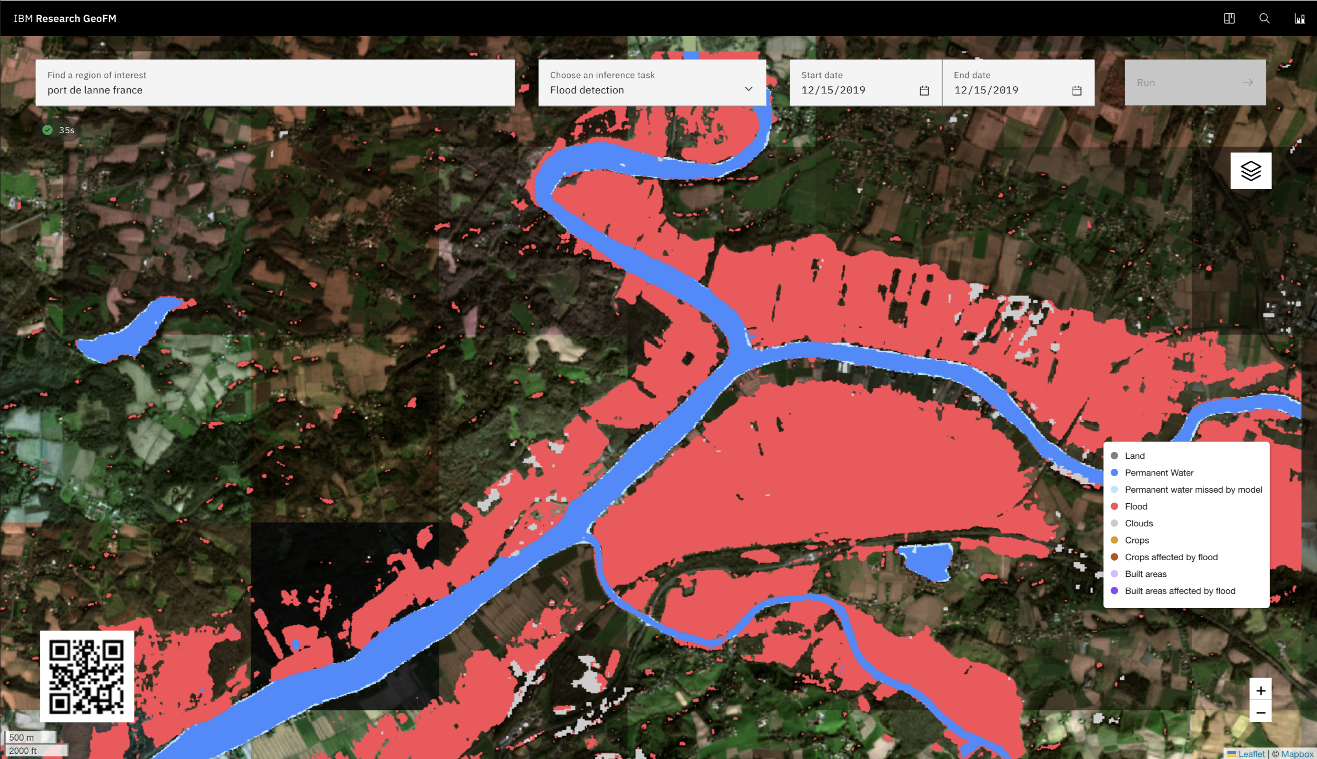
Executive Summary
Prithvi is a suite of geospatial foundation models that accelerate the development of geospatial applications. Available in IBM's watsonx.ai, it includes pre-trained (slate.prithvi.100m.hls2, slate.prithvi.300m.hls2) and fine-tuned models for disaster mapping, environmental change monitoring, and data discovery tasks (such as flood, fire scars, and land use/change), thus enabling geospatial analytics at higher accuracy, lower cost, and faster speed.
Key differentiations
Outperforms SoTA by upto 15%
Needs upto 50% less labeled data
Generalizes across applications
Pre-built workflows cut dev time from months to days
Notes:
Superior Performance: Prithvi outperforms the state of the art by up to 15%, providing more accurate results for geospatial analytics tasks.
Reduced Data Requirements: Prithvi needs up to 50% less labeled data than other models, reducing the cost and effort required to collect and label data.
Faster Data Discovery: Prithvi is 3-4 times faster than other models for data discovery tasks such as reconstruction and in-painting, enabling faster insights and decision-making.
Generalization: Prithvi can generalize across different applications, datasets, and spatial domains, providing a flexible solution for diverse geospatial analytics tasks.
Pre-built Workflows: Prithvi includes pre-built workflows that can cut development time from months to days, streamlining the model development process for faster time-to-market.

Slide 3
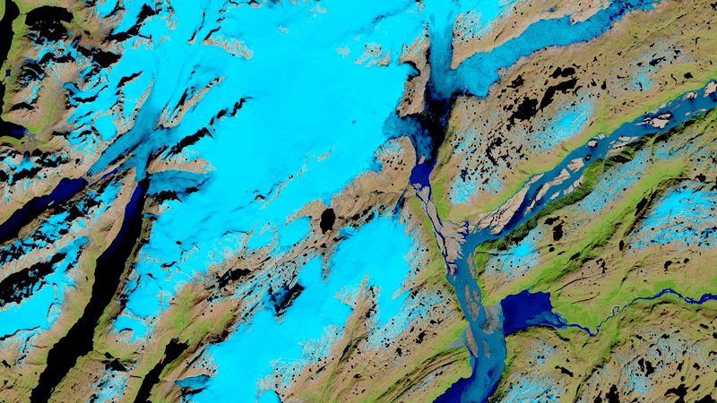
Geospatial Foundation Models
Pre-trained on sufficient datasets in partnership with content-rich institutions (e.g. NASA)
Leverage self-supervised learning (i.e., masking imagery or timeseries)
Able to effectively complete multiple downstream tasks while meeting accuracy baselines (e.g., disaster response, agriculture, and climate change)
Note: while transformer architecture is most prevalent in foundation models, definition not restricted by model architecture

Slide 4

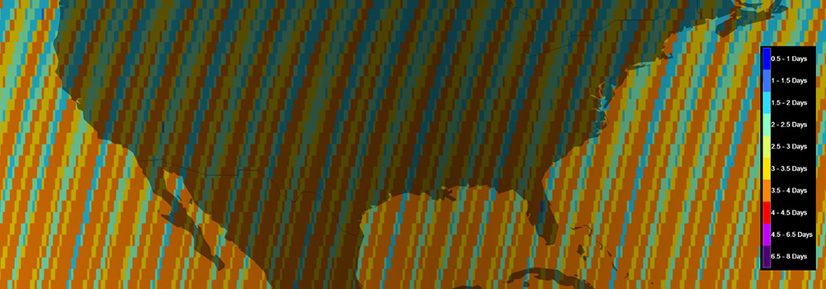
Corpus for building a GFM in NASA-IBM cooperation
Provide consistent global observations available every 2-3 days
Aligned with the Military Grid Reference System (MGRS) – 110 x 110 km tiles
70-80% cloud covers in HLS2
Notes:
What is “harmonized”?
Using data from two similar instruments and constructing an algorithm so products from each instrument can be used interchangeably
Initiative to produce a virtual constellation of surface reflectance data from Landsat 8 OLI and Sentinel-2 MSI
Spectral similarities of L8 and S2 allow for harmonization

Slide 5
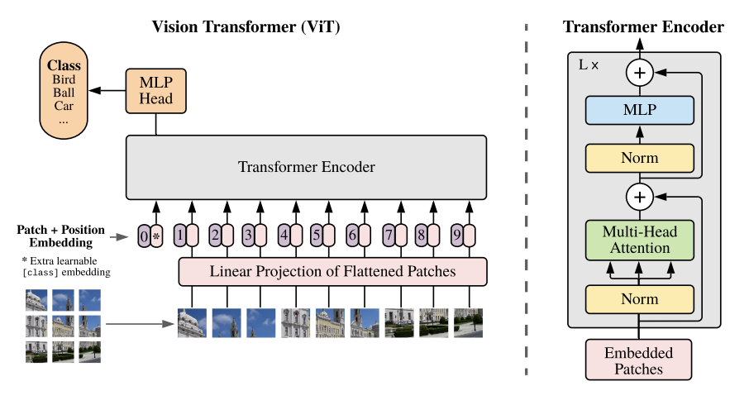
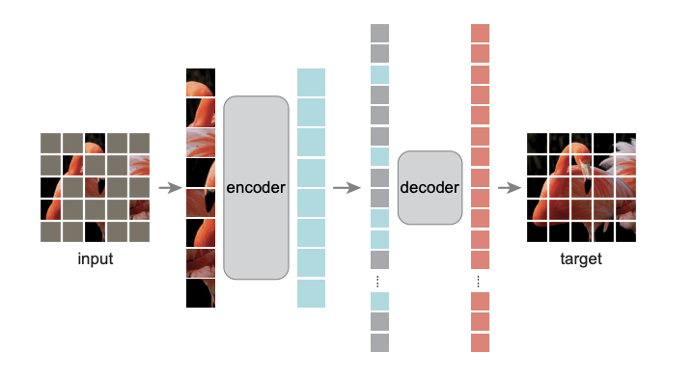
Initial approach to Training Models: Remote Sensing Data
Self-supervised encoder developed with a ViT architecture and Masked AutoEncoder learning strategy
Each HLS-2 image of 224x224 pixels divided into 14x14 patches
Spatial attention across multiple patches and temporal attention for each patch
Pixel-level MSE used as the loss function
Notes:
Data pre-processed and only non-cloud imagery chosen for training
70-80% of image is masked, similar to vision approaches
Spatial and temporal attention
Other approaches being explored: U-shaped autoencoder, FFT based feature extractor

Slide 6
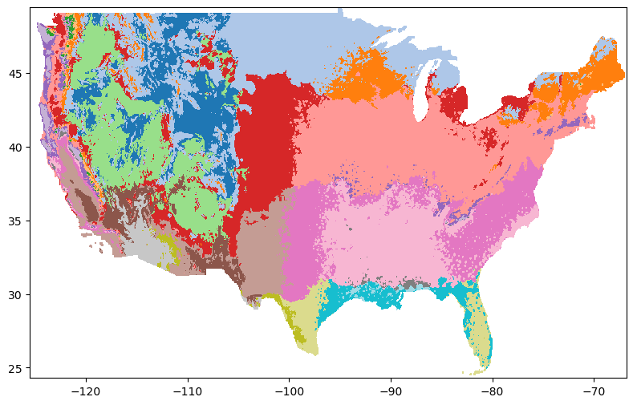
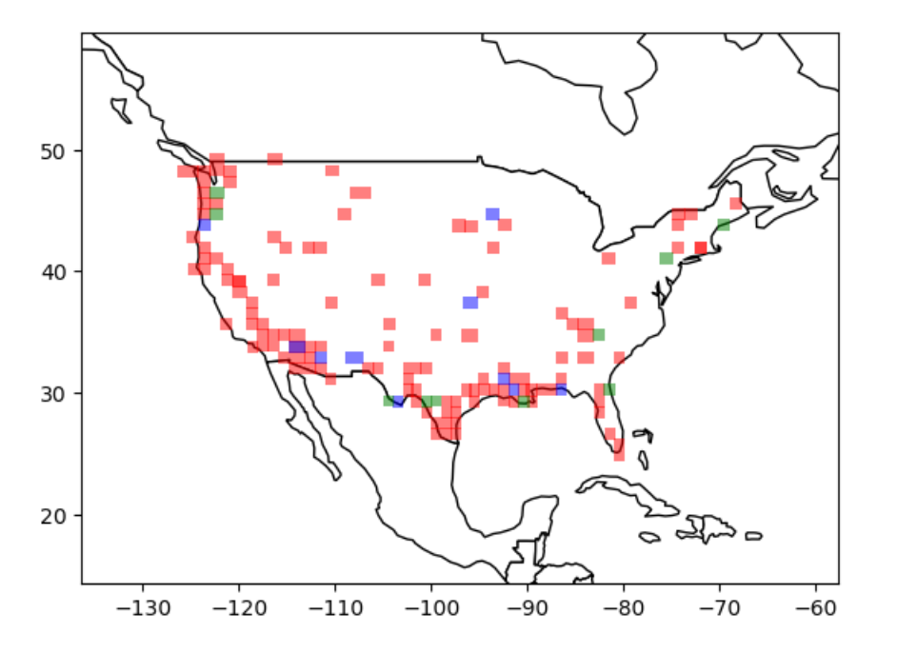
Pre-training a HLS2 Foundation Model
Pre-trained using a masking approach on 1 year of data sampled across all of United States (CONUS)
Sampling based on weather characteristics
HLS2 L30 product – 30m granularity, RGB, NIR-Narrow, and SWIR-1,2
Total data volume: 1TB
Model sizes: 100M, 300M
GPU hours: 10K

Slide 7
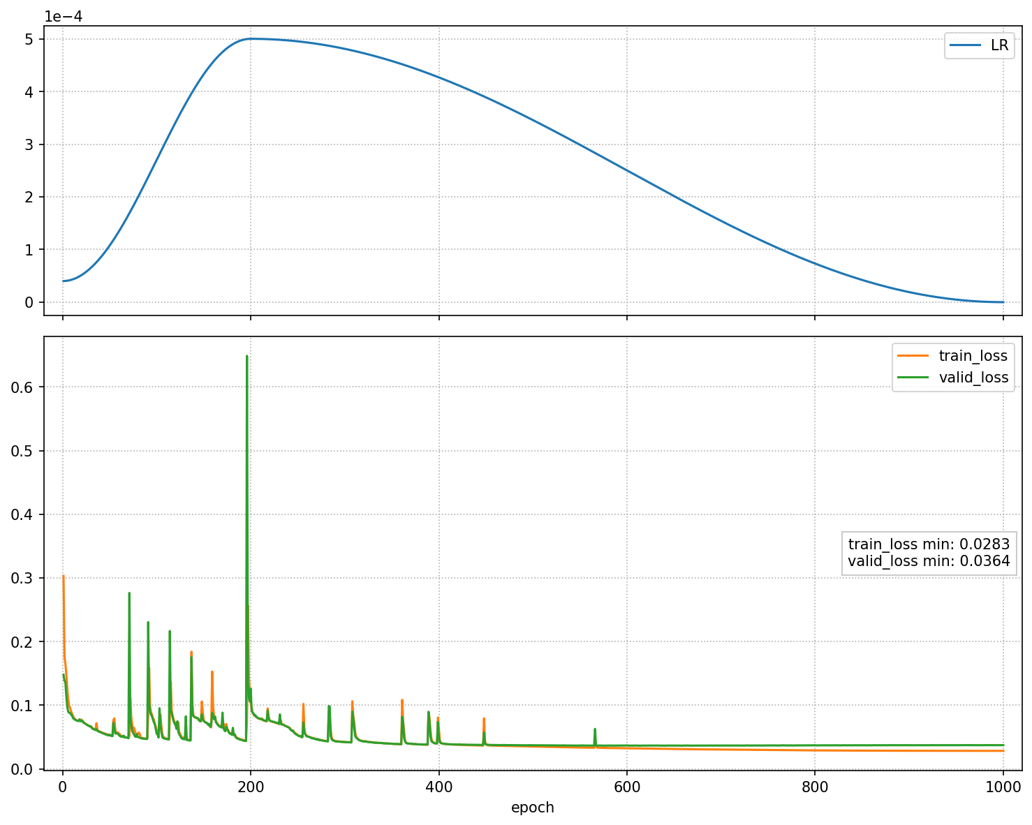
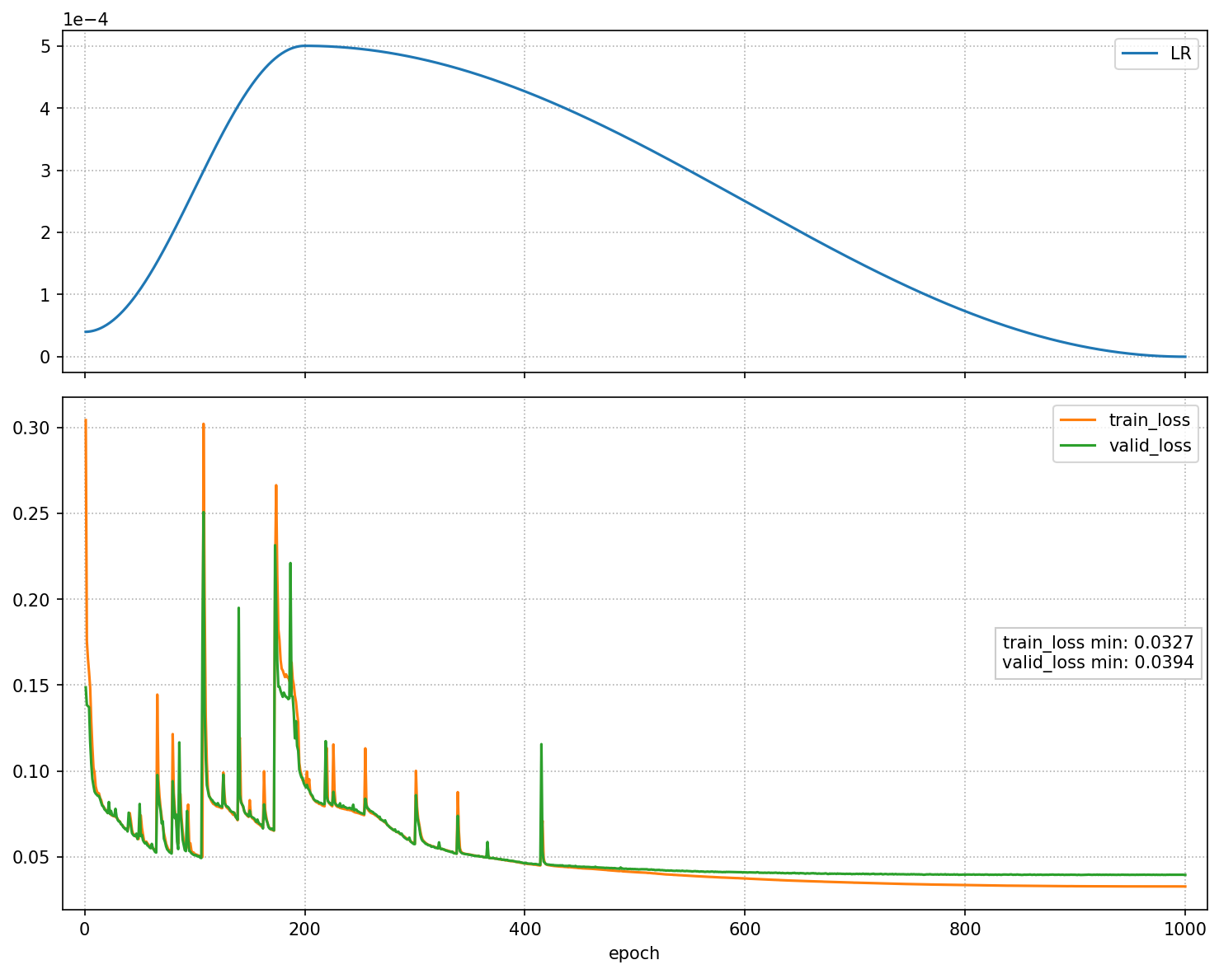
Family of models
100M model
300M model

Slide 8
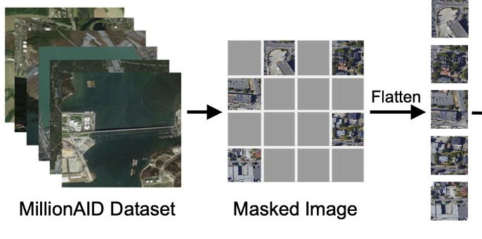
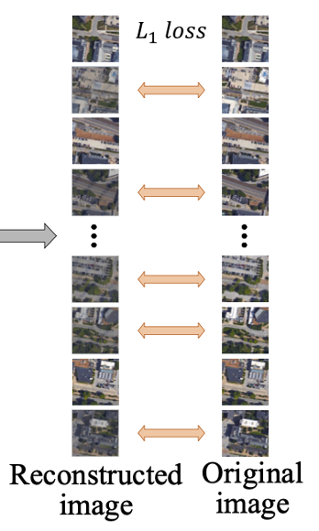
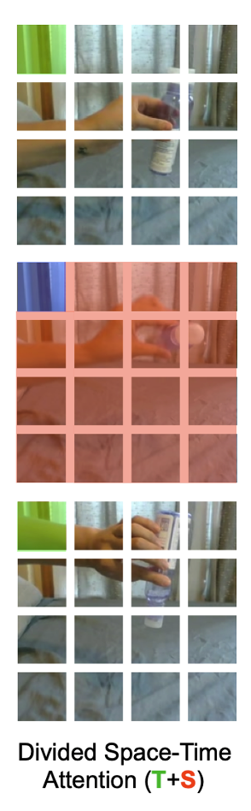
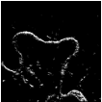
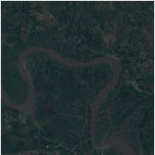
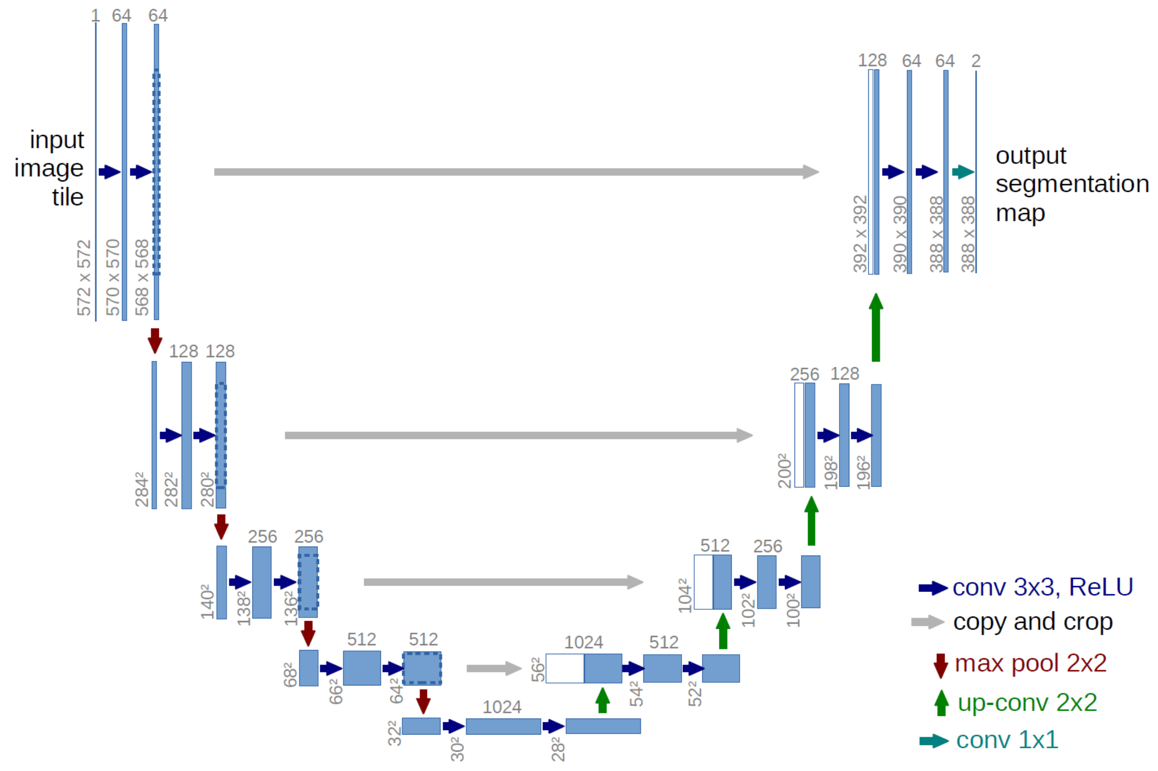
Example downstream Task: Flood Mapping
Geospatial + temporal MAE pretraining
Encoder
Decoder
Use segmentation heads to finetune and evaluate the Foundation Model
HLS data
Downstream task Application
Other downstream tasks follow similar workflow
Segmentation head
Pixel-wise classification
Original image
Comparison to SOTA

Slide 9
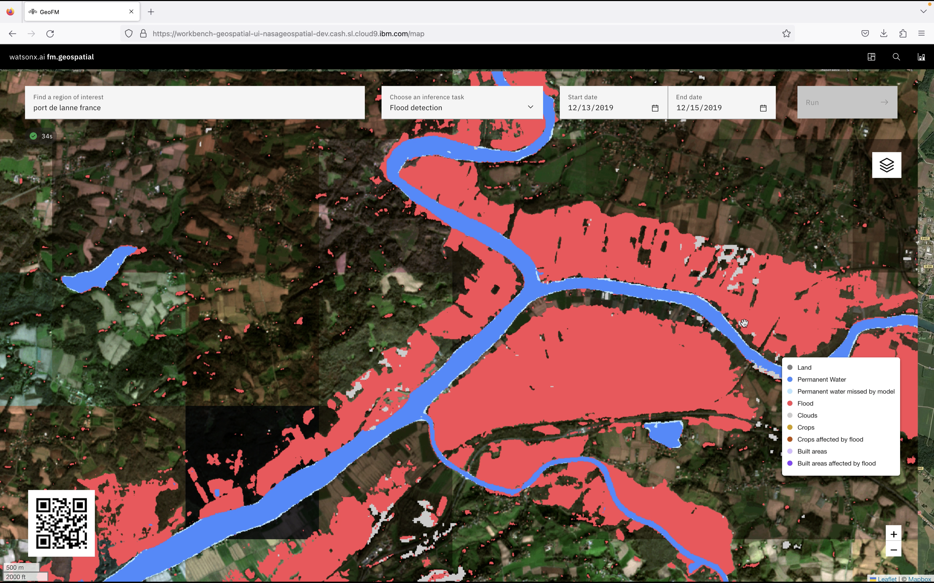
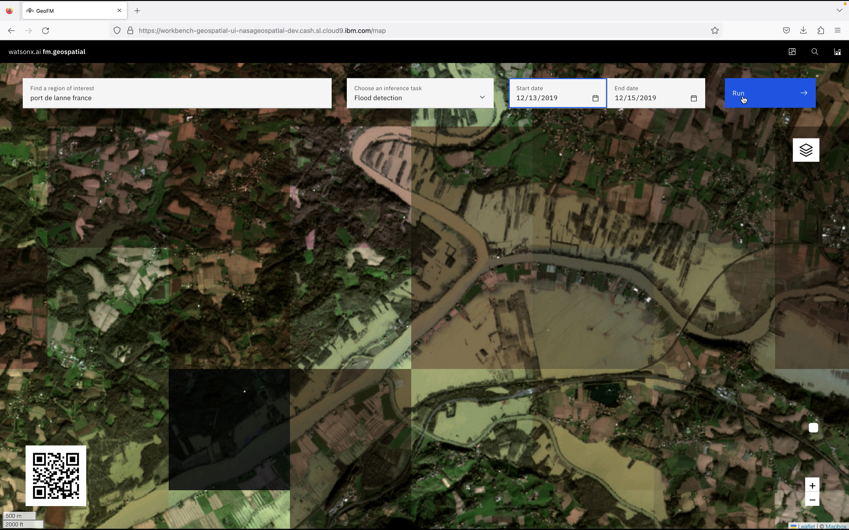
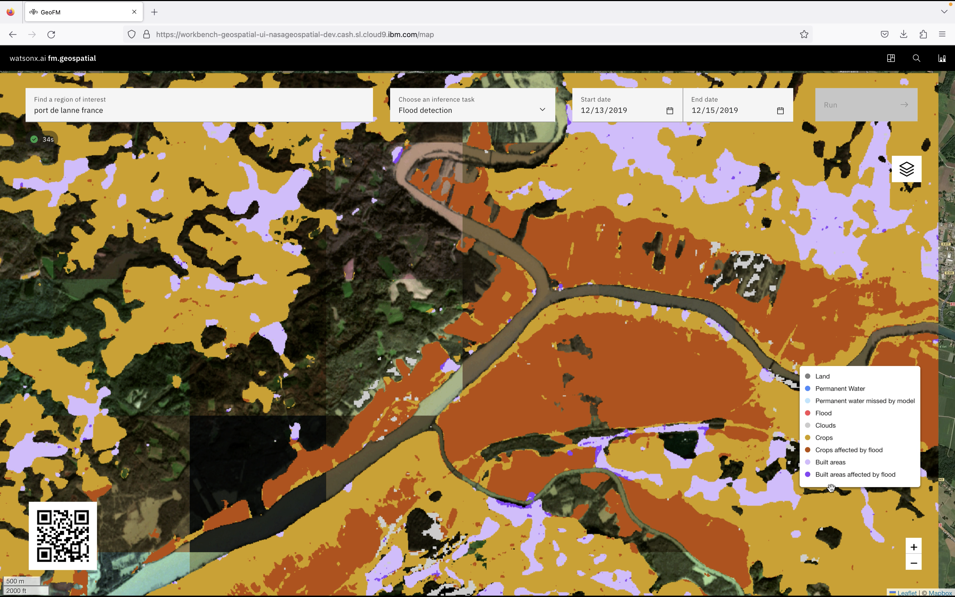
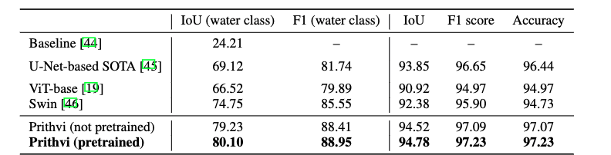
Inference insights by Prithvi – Flood Mapping
Insights: Flood detection
<< Inference>>
(e.g., flood task)
Insights: Flood impact
“Prompt”: Image(s) (spatial + temporal domains)
IBM Research / © 2023 IBM Corporation
9
Notes:
Prithvi Model A performance compared to U-Net-based baseline and SoTA on Sen1Floods11, as well as recent vision transformer architecture baselines used off-the-shelf with standard hyperparameters from [20 ]. Performance is calculated pixel-wise over the test set accounting for class imbalance

Slide 10
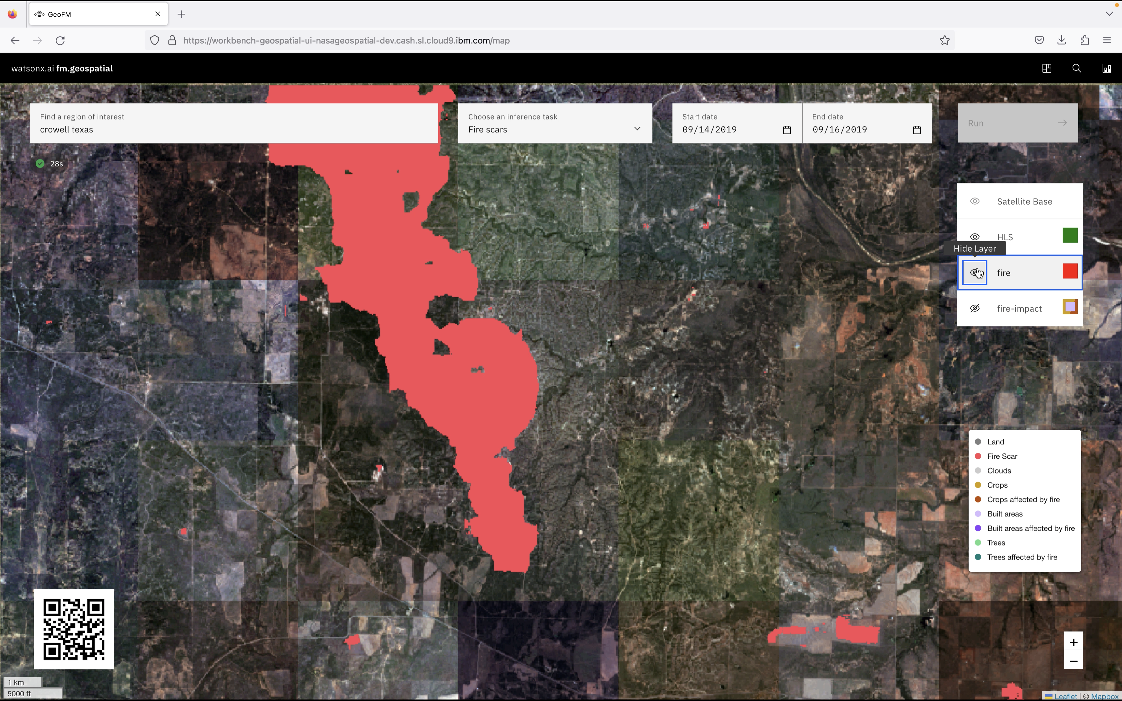
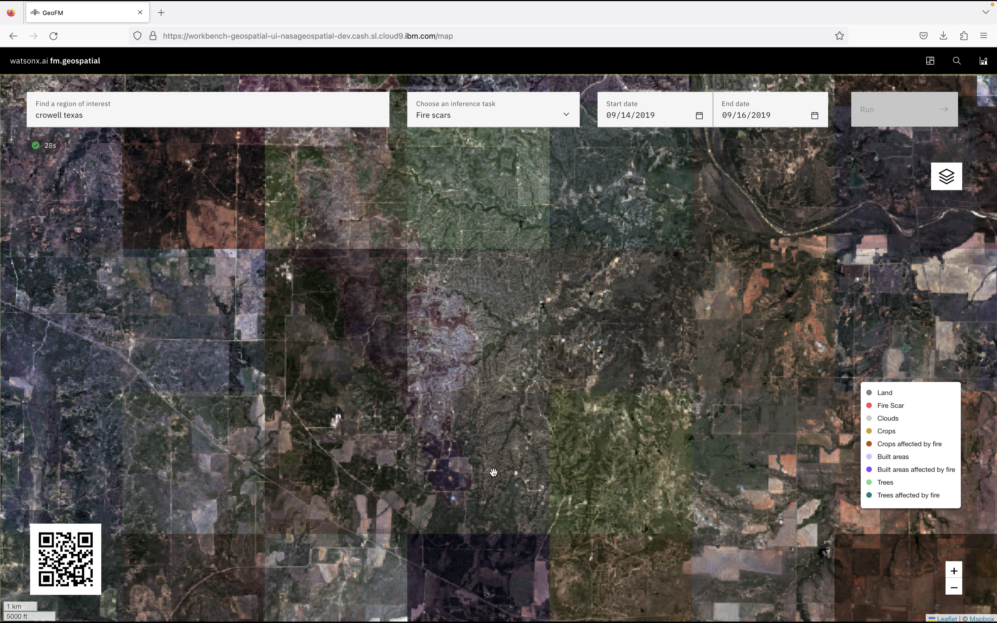
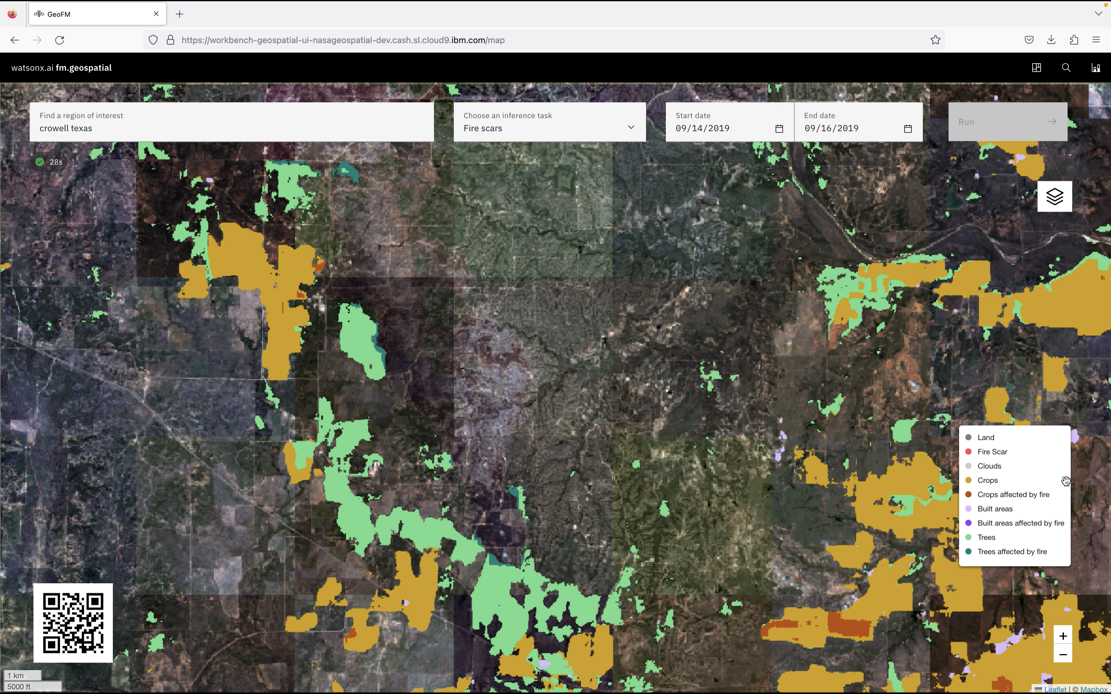
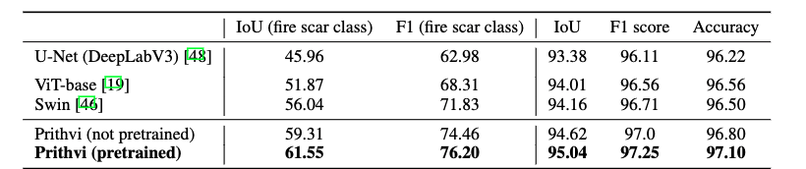
Inference insights by Prithvi – Fire Scar Mapping
Insights: fire scar detection
<< Inference>>
Insights: Fire impact
“Prompt”: Image(s) (spatial + temporal domains)
IBM Research / © 2023 IBM Corporation
10

Slide 11
Burn Scars: Detailed Experiments
Prithvi performance on burn scars with pretrained and random weights
Data efficiency of the Prithvi in terms of reduction of required labeled images for fine-tuning in the burn scars task

Slide 12
Prithvi Architectures
# base
--embed_dim 768
--depth 12
--num_heads 12
--decoder_embed_dim 512
--decoder_depth 8
--decoder_num_heads 16
# base
--embed_dim 1024
--depth 24
--num_heads 16
--decoder_embed_dim 512
--decoder_depth 8
--decoder_num_heads 16
# base
--embed_dim 1280
--depth 32
--num_heads 16
--decoder_embed_dim 512
--decoder_depth 8
--decoder_num_heads 16
Prithvi 100m
Prithvi 300m
Prithvi 600m
© 2023 IBM Corporation

